Slide 1


Predicting Customer Satisfaction for Airlines
By: Gavin Henderson, Elliot Blain, Sebastian Valdes, Oscar Diaz de la Rua, Vraj Patel
Notes:
Gavin

Slide 2


Introduction and Problem Statement
What is passenger satisfaction and why does it matter?
Real-world significance: Better customer experience, airline competitiveness
When Satisfaction is better predicted, we can tailor services which will retain customers
Objective: Use ML to predict if a passenger is satisfied or not based on flight details and demographics
Classification task
With these insights we can understand what factors contribute to satisfaction to better understand our customer
Notes:
Gavin

Slide 3

What would the Perfect Model look like?
High Accuracy
Predicts satisfaction with minimal error
Fast Predictions
Can run in real-time or near-real-time
Explainability
Easy to interpret by business stakeholders
Generalization
Performs well on new, unseen data
Low Maintenance
Doesn't require frequent retraining
Notes:
Gavin

Slide 4

Dataset Overview
Source: Kaggle – TeejMahal’s Dataset(Survey)
Size: ~129,000 entries, 24 features
Target variable: satisfaction (satisfied vs. neutral/dissatisfied)
Types of features: Demographics (e.g., Age, Gender), Service Ratings, Flight Details (e.g., Delay, Class)
Mix of Categorical and Numerical features
Notes:
Oscar

Slide 5
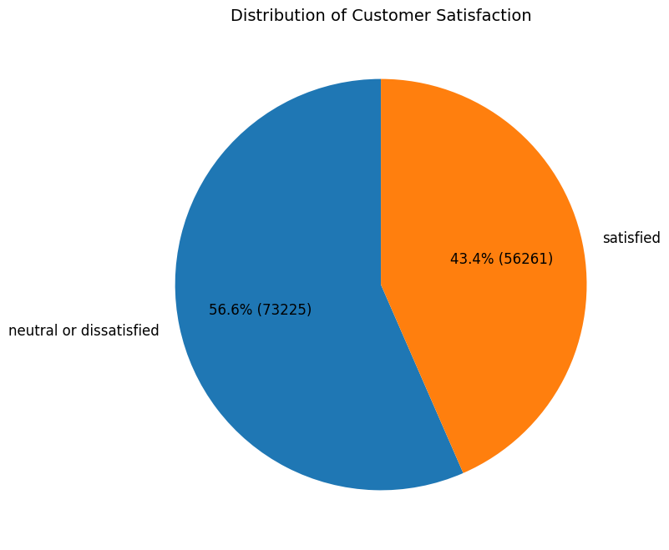
Class Distribution
We began our analysis by examining the distribution of the target variable: satisfaction.
The dataset showed a balanced distribution between satisfied and dissatisfied passengers.
Since the classes were already well balanced:
There was no need to apply SMOTE (Synthetic Minority Over-sampling Technique).
This allowed us to proceed with modeling without introducing synthetic samples, preserving data authenticity.
Notes:
Oscar

Slide 6
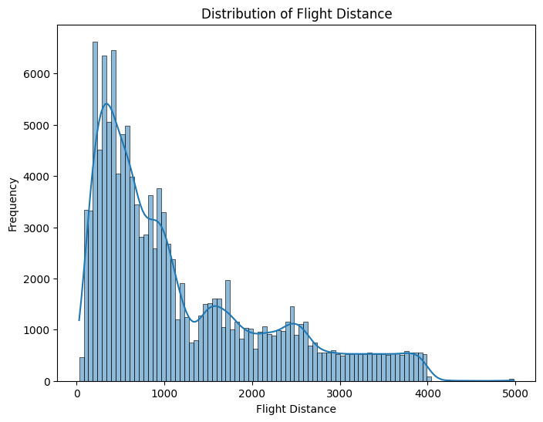

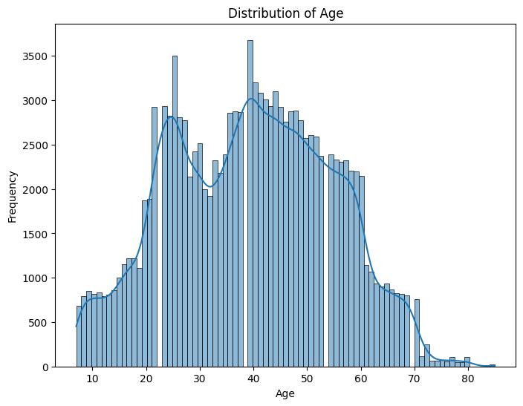

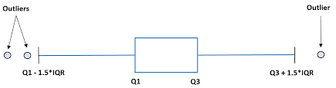
Data Preparation
Removed Null Values
Made up less than 0.01% of dataset
Removed Duplicates
To make sure we had a clean dataset
Handled outliers in Flight Distance column
Used IQR Method
Dropped the outliers
We want our data to be representative of what we are predicting
Do not want to make generalizations with limited # of examples
Leads to more stable, generalizable results
Notes:
Vraj

Slide 7
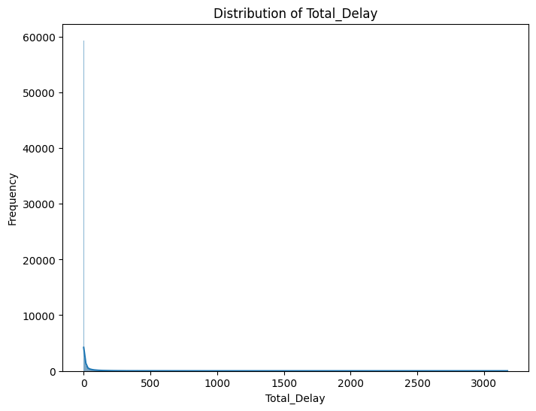
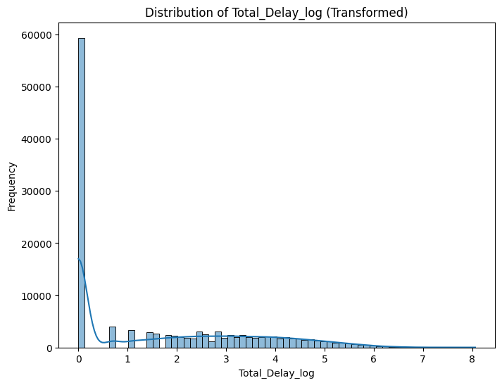
Data Preparation
Feature Engineering
Total Delay = Departure Delay + Arrival Delay
Handled assumption of no multicollinearity (97% correlated on heatmap)
Applied log transformation to Total Delay
Account for right skew
Notes:
Vraj

Slide 8
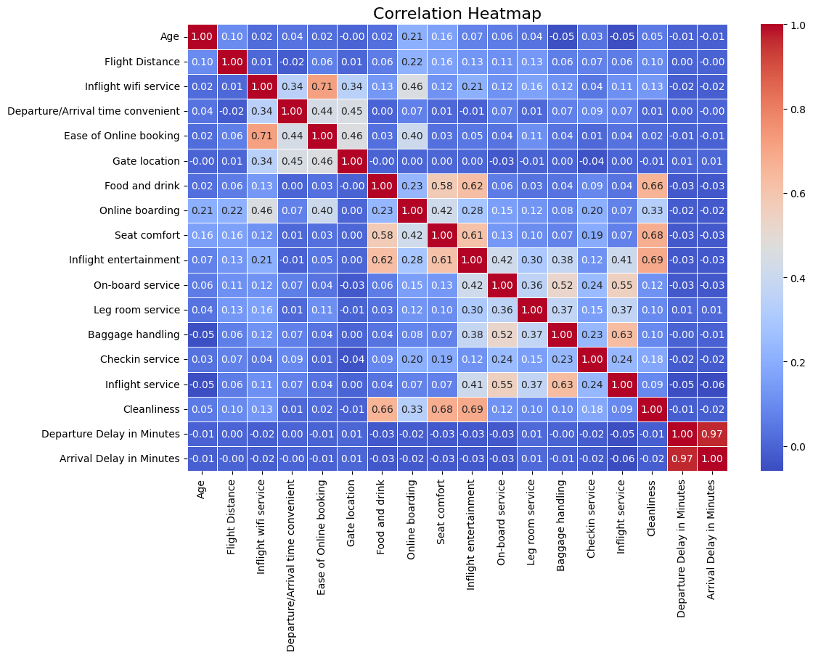
Statistical Analysis (Pearson’s Test)
Notes:
Vraj

Slide 9
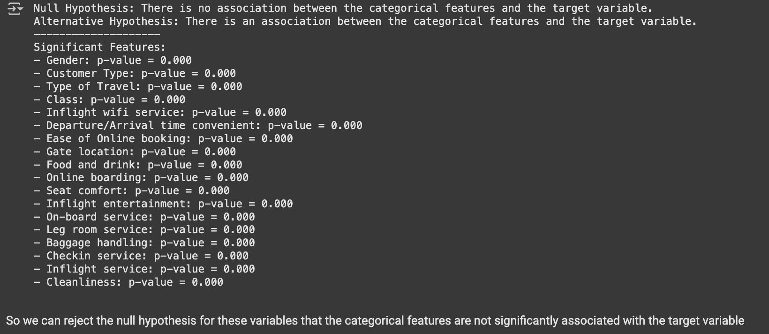
Chi-square Analysis
Hypothesis testing to see if there is an association with Target(satisfaction) and the features
H0(Null Hypothesis) : There is no association
HA(Alternative Hypothesis): There is an association
For all Categorical Variables we Reject the Null Hypothesis
Decision Criteria: p < α
Notes:
p = the probability of the null being true
α (alpha)= The threshold for significance, set at 0.05
Notes:
Vraj

Slide 10
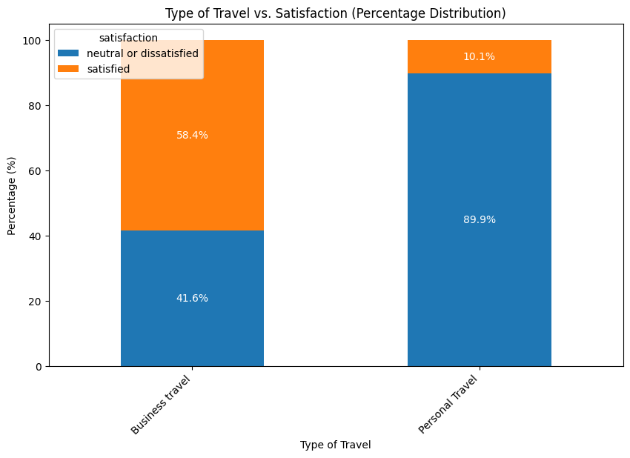
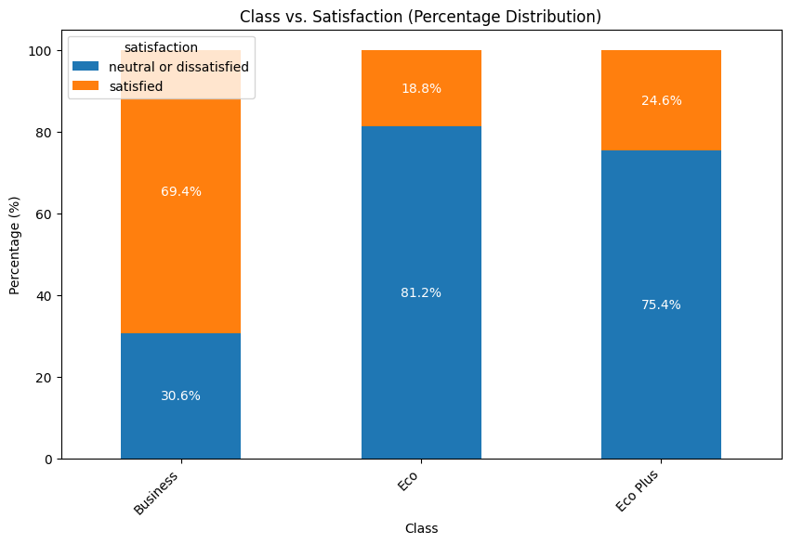
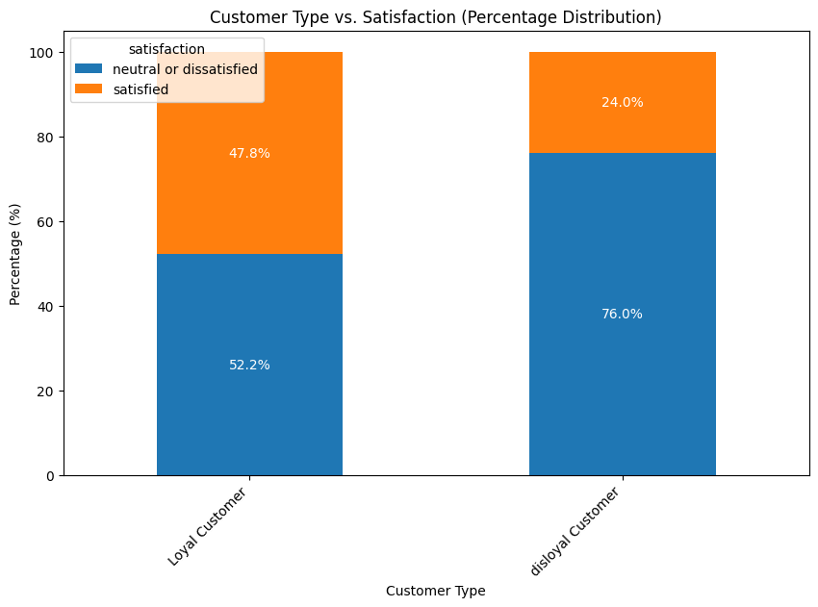
EDA
Type of Travel:
Business travelers are 40% more satisfied than personal ones — likely due to reduced cost sensitivity.
Class of Travel:
Business Class passengers report the highest satisfaction — premium experience clearly matters.
Customer Type:
Loyal customers are far more satisfied — suggesting a strong link between satisfaction and loyalty.
Takeaway: These patterns show that factors travel type, class, and loyalty status are likely influencing satisfaction — and improving these areas can drive both happier customers and higher revenue.
Notes:
Oscar

Slide 11


Data Preprocessing
Key Steps Taken:
Train/Test Split
Necessary to to evaluate model performance on unseen data
80% Training / 20% Testing
Encoding Categorical Variables
Ordinal Encoding used for variables with implied order
Class ( Eco, Eco Plus, Business)
Other categories use binary encoding
Label Encoding
Satisfaction encoded as 1 (satisfied), 0 (Neutral/Dissatisfied)
Why it matters:
Proper preprocessing ensures the model learns from meaningful patterns, not noise — directly impacting performance, reliability, and interpretability.
Notes:
Sebastian

Slide 12


Data Preprocessing
Scaling Features
Standard Scaling
Greatly improves performance, makes it easier for model to converge as we minimize our cost function
Prevents larger values from having a disproportionate impact on model predictions
Recursive Feature Elimination
Created two training sets:
One with the full feature set
One with only top 10 features selected via RFE
All models were evaluated on both to compare performance and efficiency
Notes:
Sebastian

Slide 13
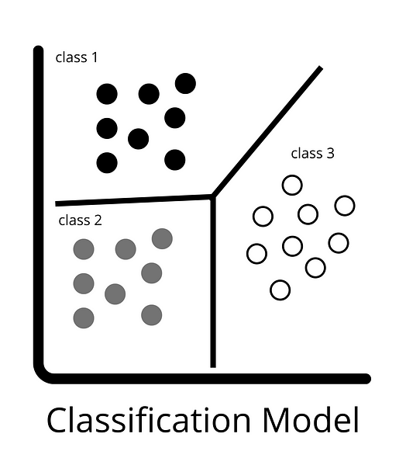
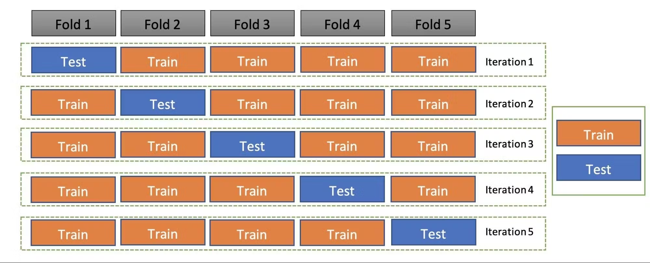
Model Selection & Hyperparameter Tuning
Source: https://iaviral.medium.com/classification-models-cb4ba55c6f4d
Model Selection:
Basic Classification Models:
SVM
Logistic Regression
Decision Tree
KNN
Deep Learning:
Neural Network
Ensemble Methods:
Bagging
Random Forest
Boosting:
XGBoost
AdaBoost
Stacking
Base Learners: Decision Tree, Random Forest, SVM
Meta Learner: Logistic Regression
Hyper Parameter Tuning
Grid Search on All Models
To find optimal parameters
Cross Validation
5 fold
Notes:
Elliot

Slide 14


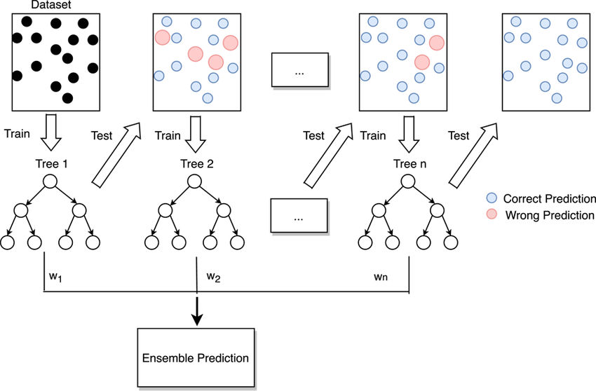

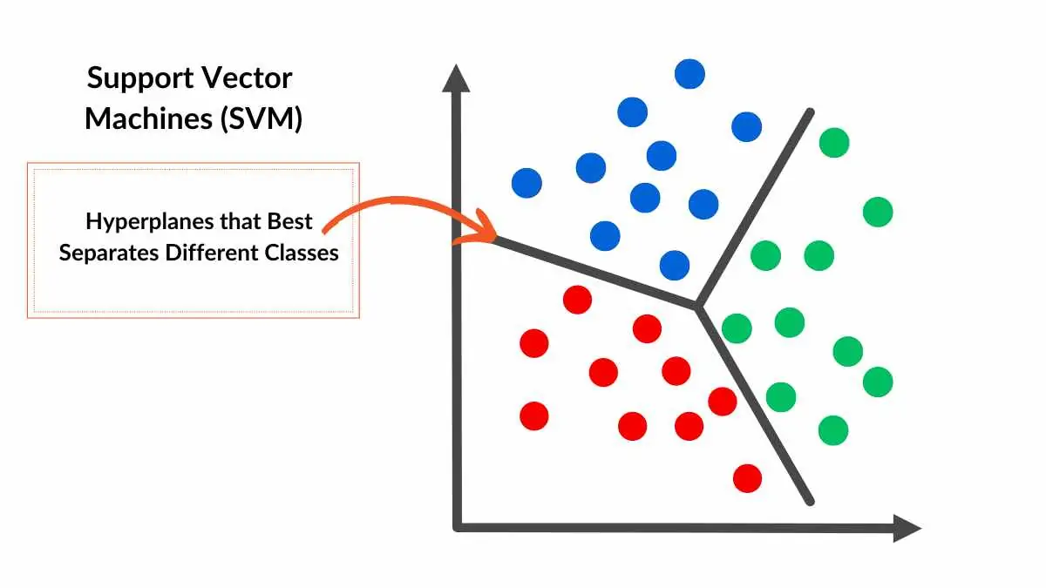
Best 5 Performing Models
All had over 95% Accuracy
Neural Networks
Great for capturing complex patterns
XGBoost
Powerful boosting algorithm, handles non-linearity and avoids overfitting
Random Forest
Strong ensemble method, reduces variance and improves accuracy
Stacking
Combines multiple models to boost overall performance
SVM
Effective in high-dimensional spaces, finds optimal decision boundaries
Notes:
Elliot

Slide 15

Worst Performing Models
All had under 95% Accuracy
Logistic Regression
Not useful for non-linear relationships, complex interactions, overfits in high dimensional datasets
Adaboost
Requires careful parameter tuning, sensitive to noisy data/outliers
KNN
Not ideal for large datasets or imbalanced classes
Decision Tree
Prone to overfitting and have a large computational cost
Source:https://www.gettyimages.com/detail/photo/arrows-miss-and-hit-a-red-target-achievement-and-royalty-free-image/1386737640
Notes:
Elliot
Logistic Regression had 87% accuracy. It is not useful for non-linear relationships, complex interactions, overfits in high dimensional datasets
Adaboost had 93% accuracy. It requires careful parameter tuning and is susceptible and sensitive to noisy data and outliers which leads to a less accurate model.
KNN had 93% accuracy. KNN is a lazy learner so it is not ideal for large datasets as it negatively affects its performance, it is also not suited for imbalanced classes as it can be biased towards the majority class
Decision Tree had 94% accuracy. It is prone to overfitting when the tree becomes to deep and complex and have a large computational cost when used on large datasets

Slide 16
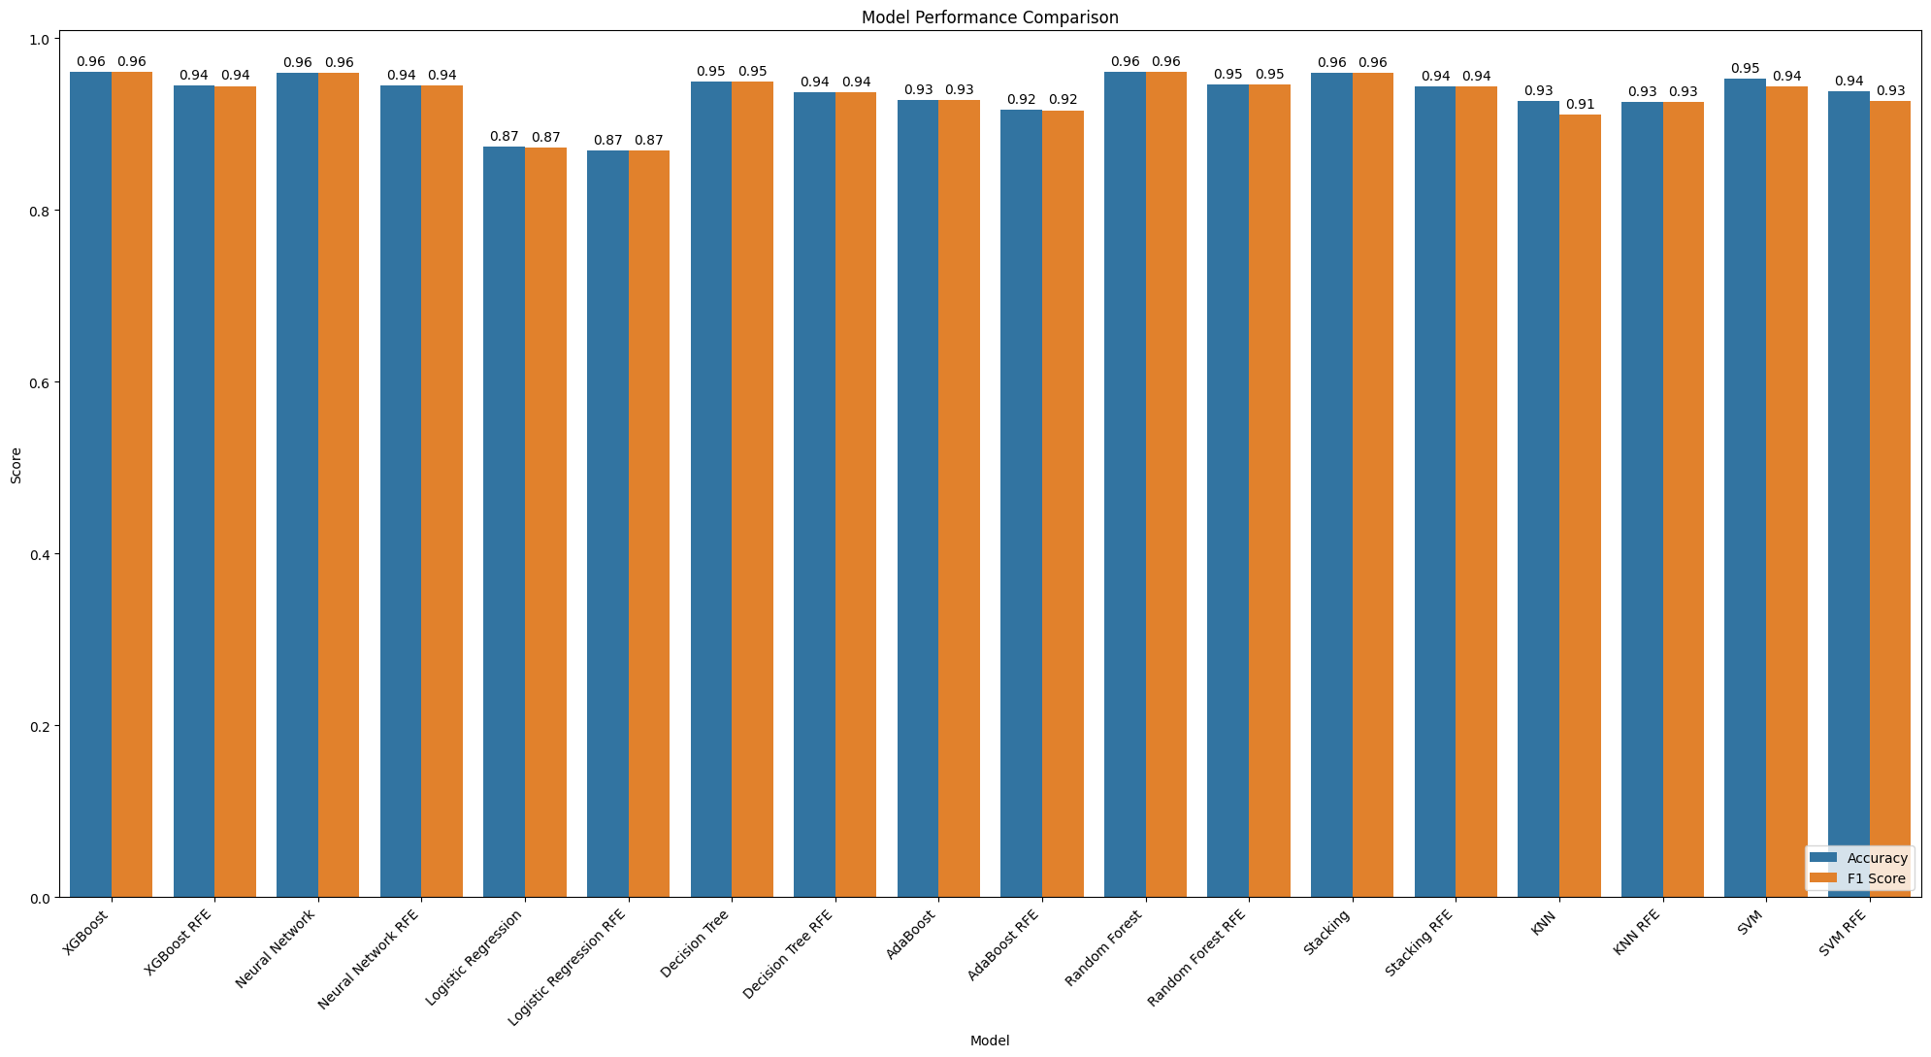
Notes:
Elliot
All of the models have a pretty high accuracy rate except for logistics regression.
RFE allowed for faster training and helps improve the model performance

Slide 17
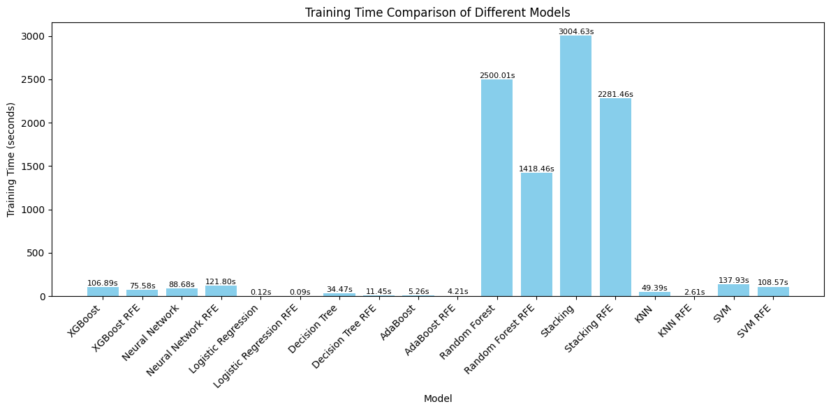
*KNN and SVM training time would likely have been much higher, but the models would not do Grid Search on our computers
Notes:
Vraj

Slide 18


Experimental Results - RFE
Key Findings:
Reduced Training Time:
RFE consistently decreased model training time across all trials compared to using the full feature set.
Trade-off Observed:
Despite faster training, RFE often resulted in reduced model accuracy or no improvement at all — indicating information loss.
Choice of Feature Count Matters:
We arbitrarily selected 10 features, but with 23 available, exploring a range (e.g., 15, 18, 20) could have led to better balance between speed and accuracy.
Business Implication:
In real-world applications, speed and efficiency are valuable, especially in time-sensitive environments. However, we must balance computational efficiency with the cost of lost predictive power, which can impact business decisions.
Notes:
Sebastian

Slide 19
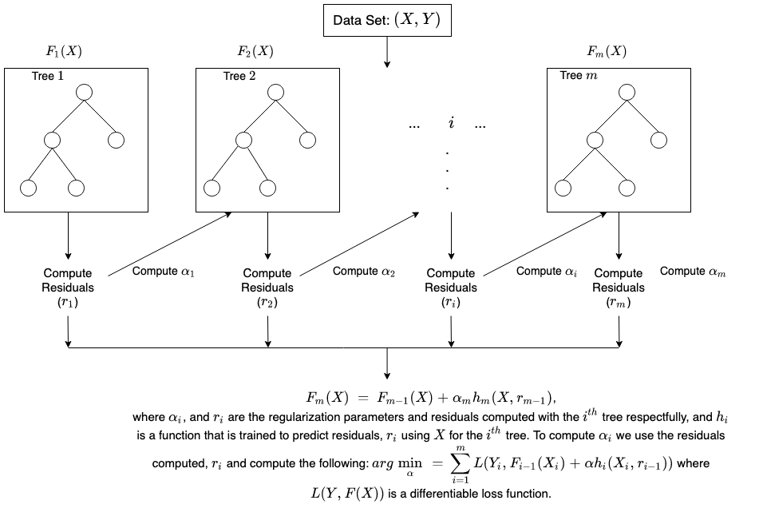
XGBoost as the Optimal Model: Balancing Accuracy, Efficiency, and Interpretability
XGBoost is the optimal model, balancing accuracy, efficiency, and interpretability to offer the best trade-off between performance and training time, making it the ideal choice for our use case.
Best parameter: Learning Rate = 0.2, Max Depth = 5, Number of Estimators = 150
Moderate Training Time(~2 minutes)
High Accuracy(96%)
Better Interpretability than other high performing models
When considering against other models:
Random Forest
Much slower when training
Stacking
Output is not interpretable & hard to deploy
SVM
Slow with large volume of training data
NN
Black Box, Slower Training
Notes:
Gavin

Slide 20
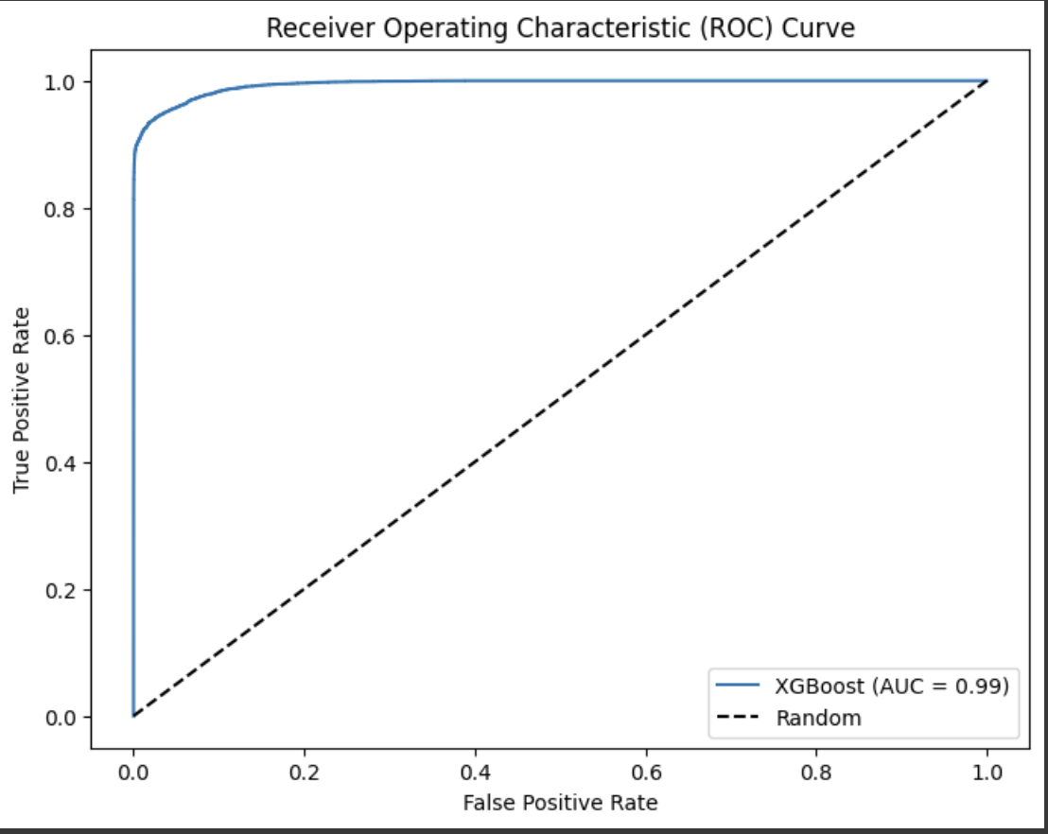
ROC AUC Curve
AUC quantifies the model’s ability to separate positive and negative classes across all thresholds
Measures the model's ability to distinguish between classes:
AUC of 1.0 = Perfect, and 0.5 = No better than random
Our model doesn’t just predict—it predicts with confidence.
Notes:
Gavin

Slide 21
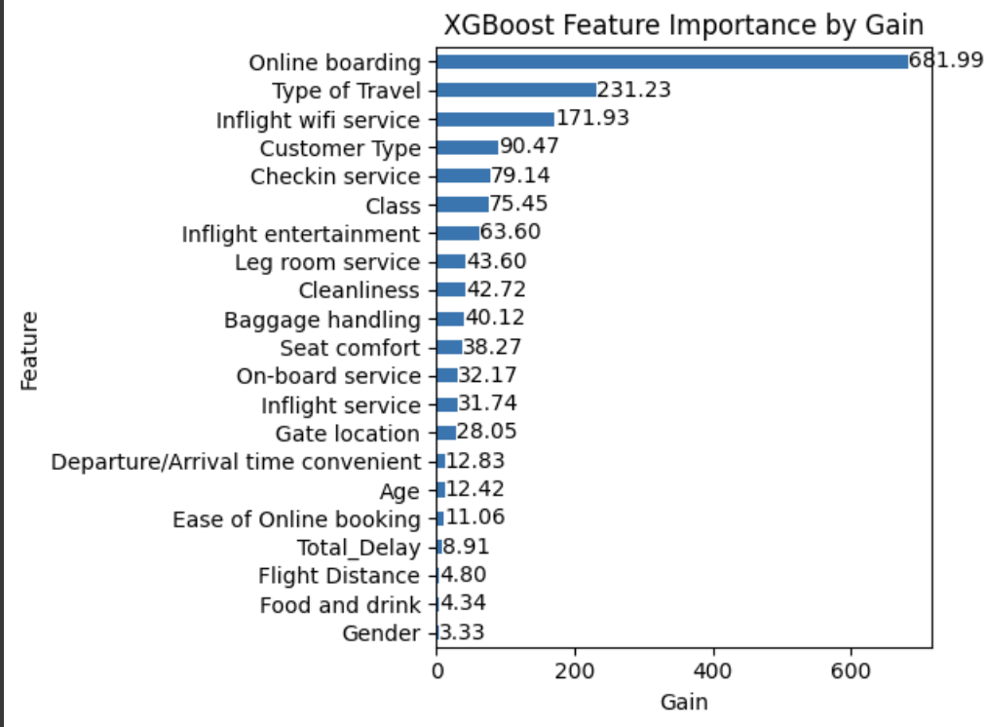
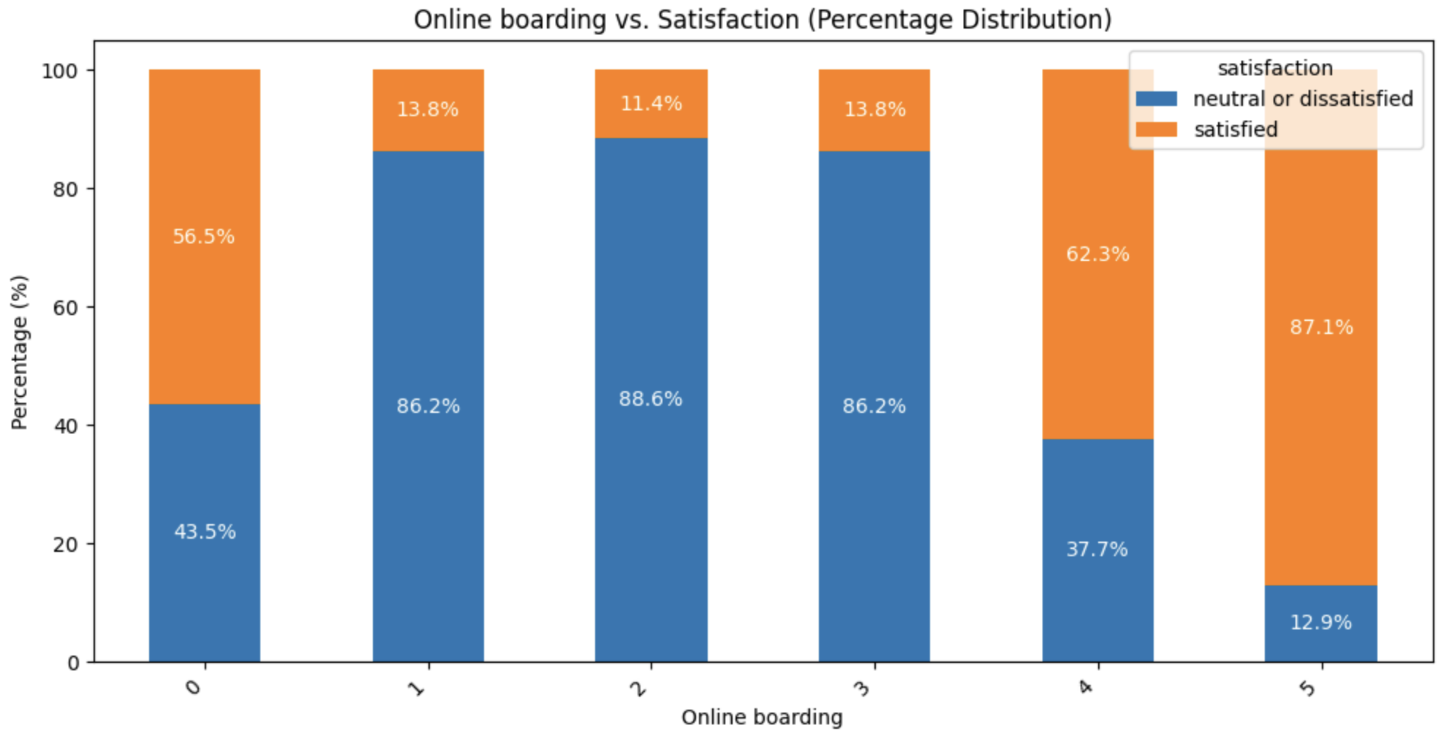
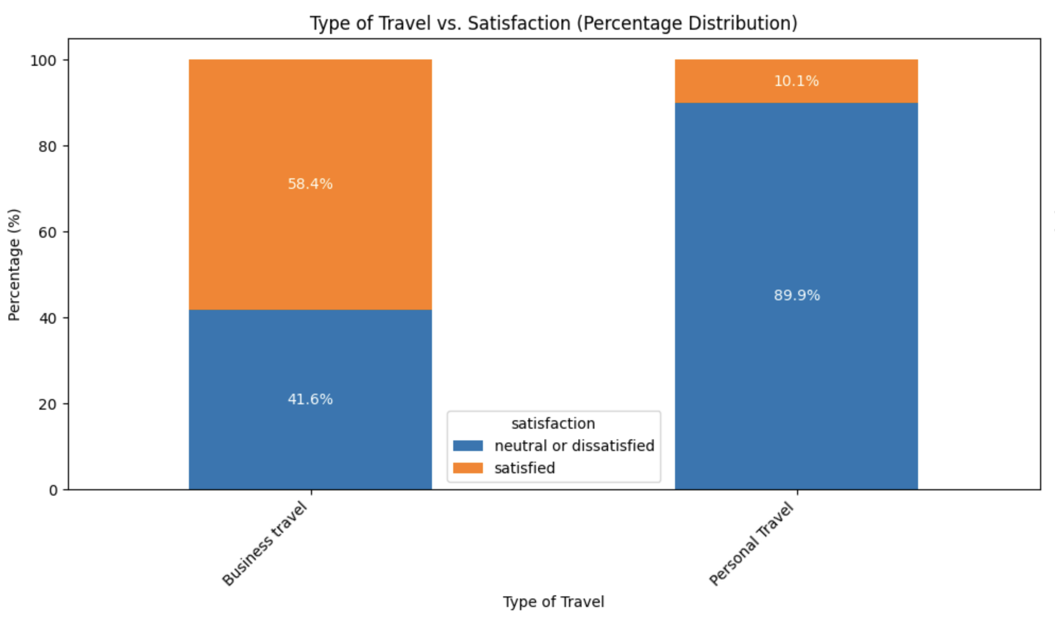
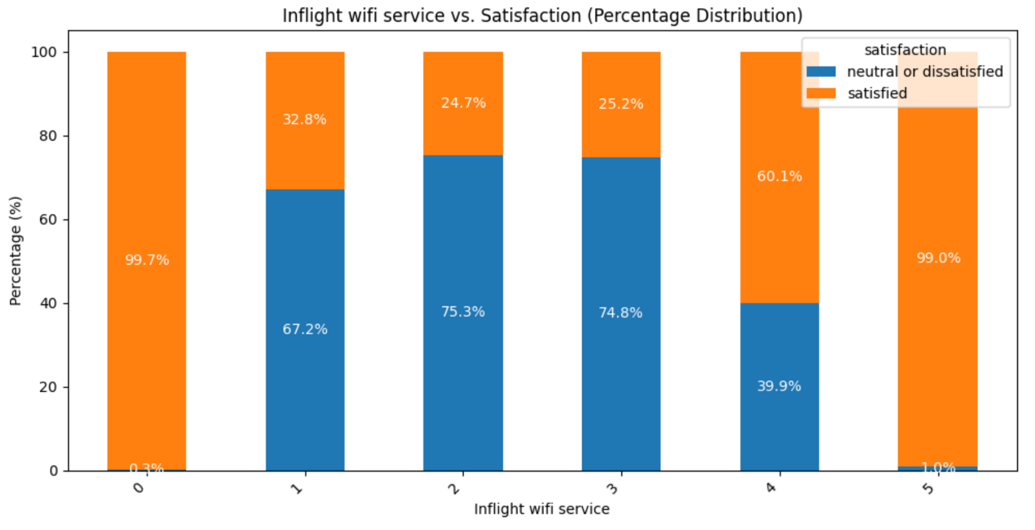
Interpreting Final Model
“Gain”
Measures how well a feature helps in splitting the data, indicating its importance in predicting the target variable.
What can we do with these results:
What Can We Do With These Results:
Identify the most important features for making predictions.
Prioritize these features for model improvement or further analysis.
Focus on features that show the greatest impact on customer satisfaction.
1.
2.
3.
Notes:
Gavin

Slide 22





Limitations
Limitations:
Computational Power:
Training models with large datasets is time-consuming and limit the efficiency of our analysis
Restricted Domain & Customer Knowledge:
The dataset may not fully represent all customers experiences.
Aging Data:
The data used may be outdated and not reflect current trends.
Inability to Conduct A/B Testing:
Real-time changes can't be tested to validate recommendations.
Binary Outcome Limitation:
model’s binary outcome (Satisfied or Neutral/Dissatisfied) limits nuanced insights.
Notes:
Sebastian

Slide 23


Future Recommendations
Good news:
Most of the highest contributing factors (e.g., Wi-Fi quality, Online Boarding) are in our control, allowing for targeted improvements.
Features like age and gender have lower importance, meaning we can focus on what we can change.
Future Recommendations:
Increase Investment in Service Areas: Focus on enhancing Wi-Fi and Online Boarding to improve satisfaction.
Expand Customer Data Collection: More data will help refine our model, identify patterns, and make targeted improvements.
Notes:
Oscar

Slide 24
Appendix
Extra Model Confusion Matrices:
25-33
More XGBoost Interpretation:
34

Slide 25
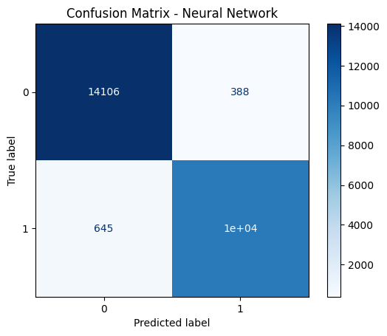
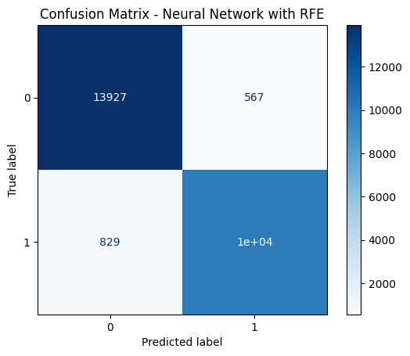
Experimental Results - Neural Network
Regular
RFE
Notes:
Simple Neural Network: # Regular Model
nn_model = keras.Sequential([
keras.layers.Input(shape = (X_train.shape[1],)),
keras.layers.Dense(64, activation = 'relu'),
keras.layers.Dense(128, activation = 'relu'),
keras.layers.Dense(128, activation = 'relu'),
keras.layers.BatchNormalization(),
keras.layers.Dense(64, activation = 'relu'),
keras.layers.Dense(1, activation = 'sigmoid')
])
Timing not included, since early-stopping triggers

Slide 26
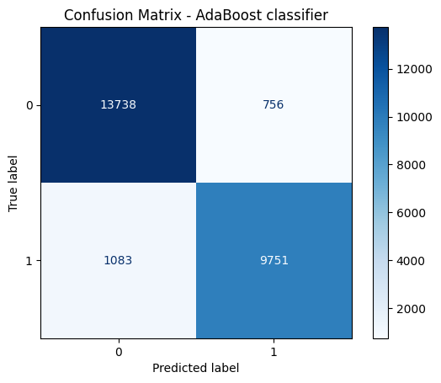

Experimental Results - AdaBoost
Regular
RFE

Slide 27
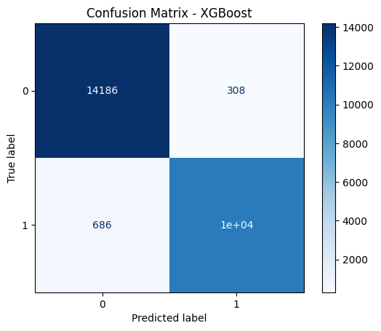

Experimental Results - XGBoost
Regular
RFE

Slide 28
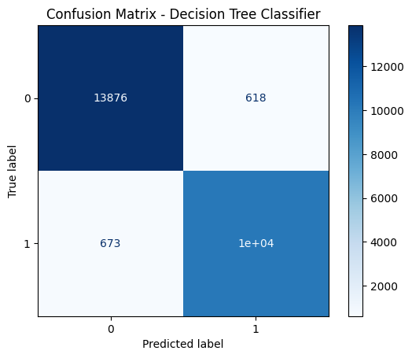
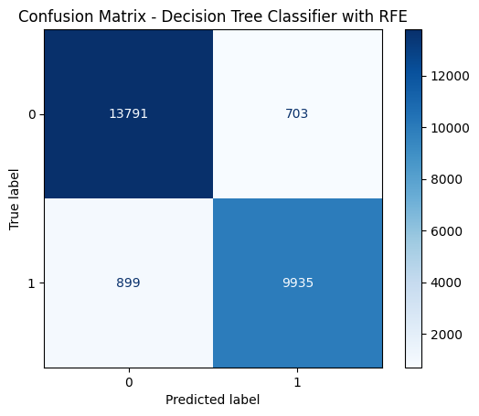
Experimental Results - Decision Tree
Regular
RFE
Notes:
Decision tree is used for regression and classification tasks. It has a wide variety of applications such as marketing, manufacturing and retail. So it is a good model to use for predicting customer satisfaction. Accuracy is the amount of correct predictions divided by the total number of input samples. The decision tree accuracy is 0.887 so fairly accurate. Precision is the true positive divided by the predictive results, the decision tree got precision score of 0.934 which is very good. Recall is the true positive divided by the actual results and the decision tree model got a recall of 0.8866 which is fairly accurate. F1 score is balances the tradeoff between precision and recall, the decision tree got an f1 score of 0.8849 which is a fairly good result.

Slide 29
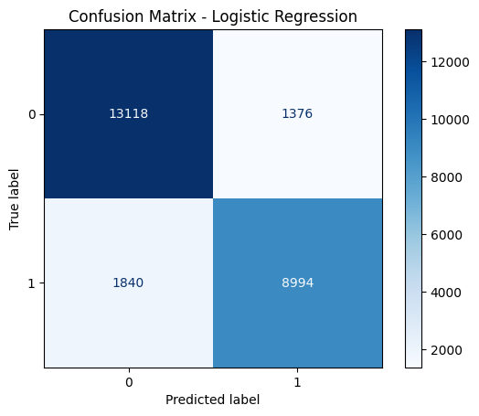
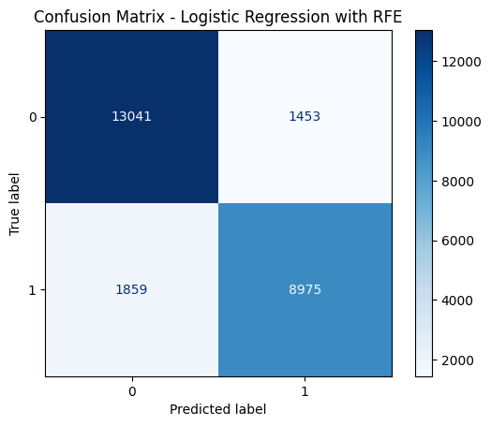
Experimental Results - Logistic Regression
Regular
Regular
RFE
RFE

Slide 30
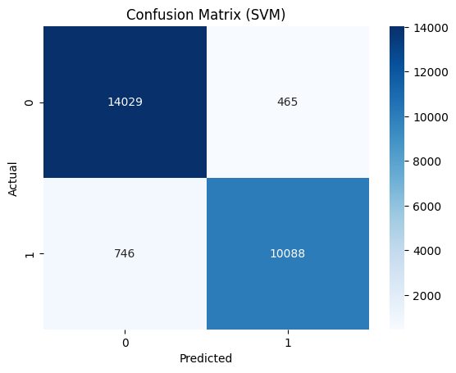
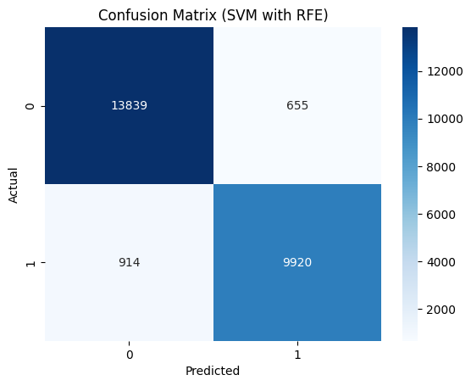
Experimental Results - Support Vector Machine
Regular
Regular
RFE
RFE

Slide 31


Experimental Results - KNN
Regular
Regular
RFE
RFE
Notes:
The KNN model is a good model to use because of its simplicity, ease of implementation and is non parametric. The KNN model outputted high model accuracy, precision, recall, and f1 score.

Slide 32


Experimental Results - Random Forest

Slide 33
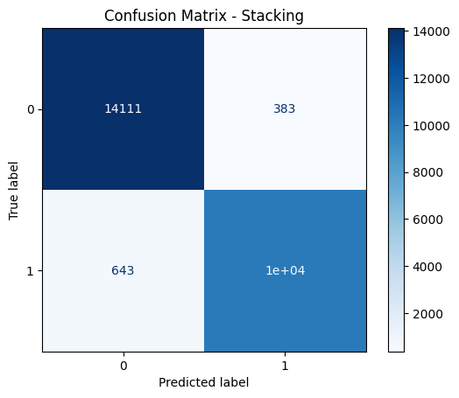

Experimental Results - Stacking
Regular
RFE

Slide 34
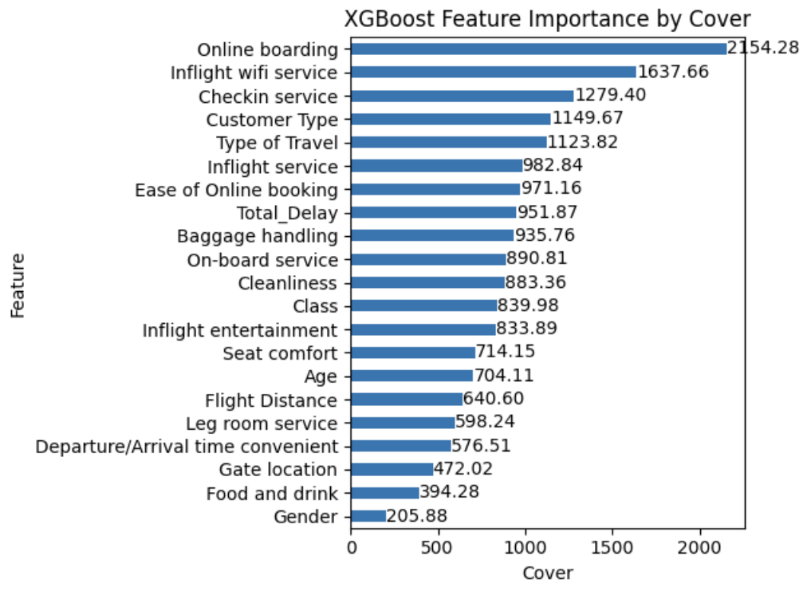
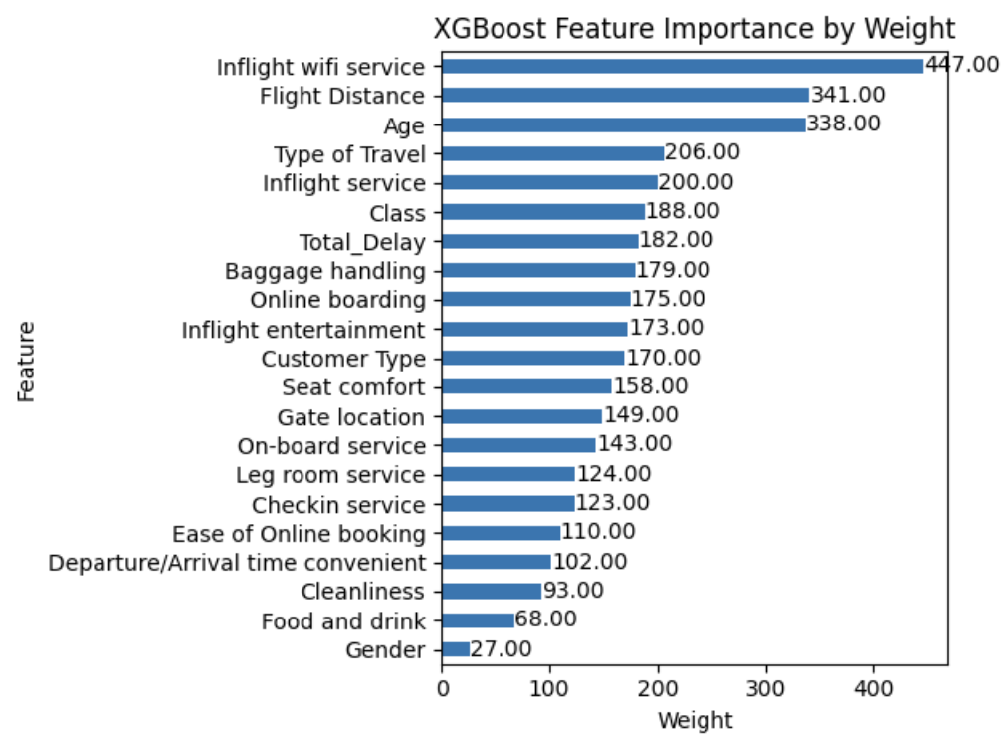
XGBoost Interpretation

